Slide 1
DEPARTMENT OF MATHEMATICS
SGGSJ GOVERENMENT COLLEGE
PAONTA SAHIB

Slide 2
COURSE NAME : VECTOR CALCULUS
COURSE CODE : 310 th

Slide 3
CONTENTS
Indefinite integral.
Problem based on Indefinite integral.
definite integral.
Problem based on definite integral

Slide 4
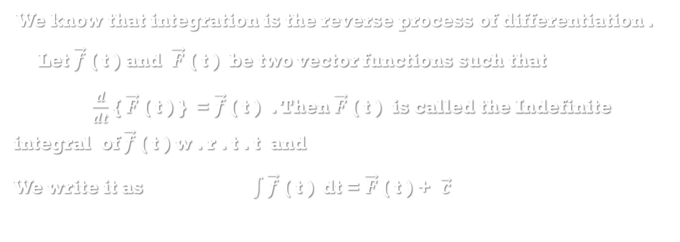
Indefinite integral
We know that integration is the reverse process of differentiation .
Let $\vec{f}$ ( t ) and $\vec{F}$ ( t ) be two vector functions such that
$\frac{d}{dt}$ { $\vec{F}$ ( t ) } = $\vec{f}$ ( t ) . Then $\vec{F}$ ( t ) is called the Indefinite integral of $\vec{f}$ ( t ) w . r . t . t and
We write it as $\int{\vec{f}\text{ ( }\text{t}\text{ )} }$dt = $\vec{F}$ ( t ) + $\vec{c}$

Slide 5
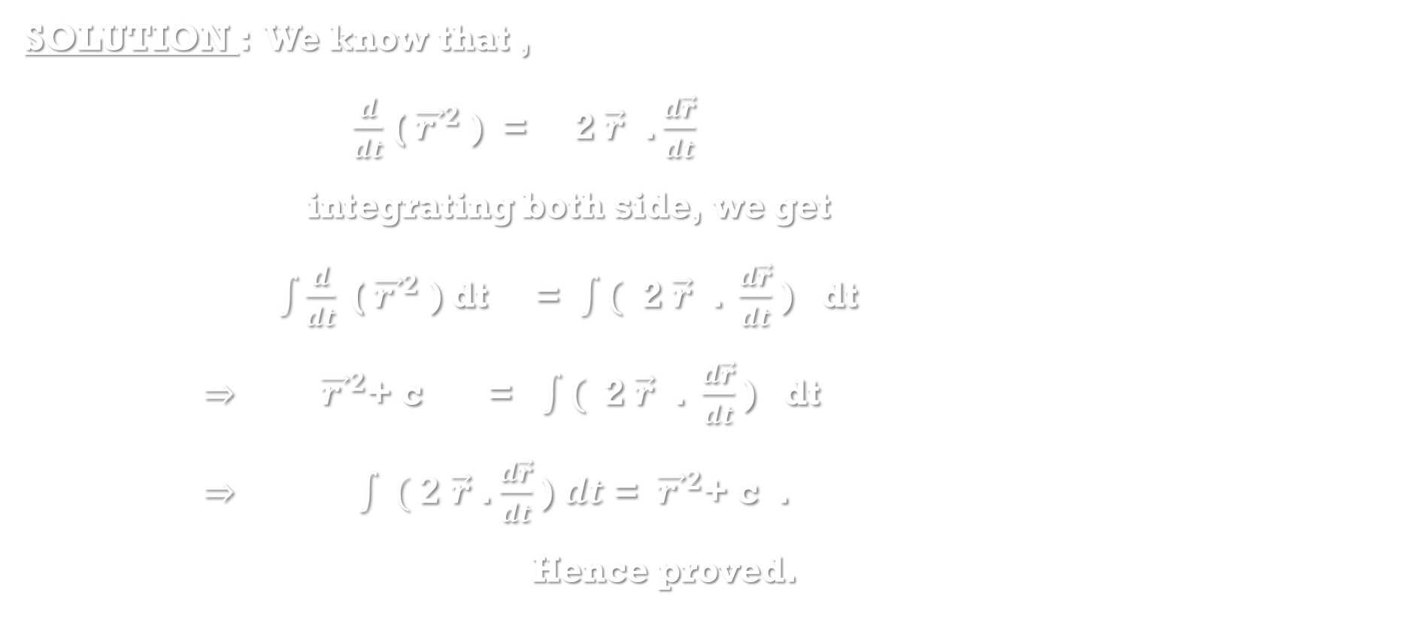
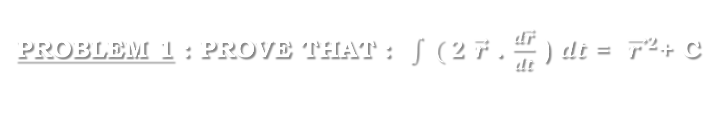
Problem 1 : prove that : $\int{ ( 2 \vec{r}}$ . $\frac{d\vec{r}}{dt}$ ) $ⅆt$ = ${ \vec{r }}^{2}$+ c
SOLUTION : We know that ,
$\frac{d}{dt}$ (${ \vec{r }}^{2}$ ) = 2 $\vec{r}$ . $\frac{d\vec{r}}{dt}$
integrating both side, we get
$\int{\frac{d}{dt}\text{ (}{ \vec{r }}^{2}\text{ )}}$ dt = $\int{\text{(}\text{ 2 }\vec{r}\text{ . }\frac{d\vec{r}}{dt}}$ ) dt
$⇒$ ${ \vec{r }}^{2}$+ c = $\int{\text{(}\text{ 2 }\vec{r}\text{ . }\frac{d\vec{r}}{dt}}$ ) dt
$⇒$ $\int{ ( 2 \vec{r}}$ . $\frac{d\vec{r}}{dt}$ ) $ⅆt$ = ${ \vec{r }}^{2}$+ c .
Hence proved.

Slide 6
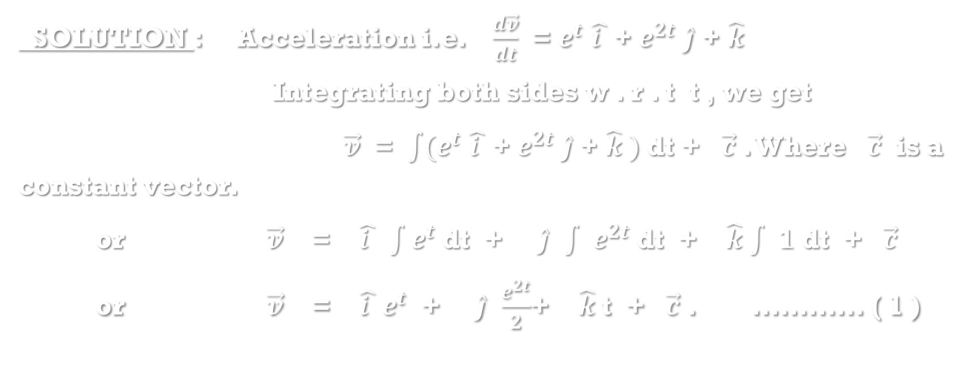

Problem 2 : The acceleration of a particle at any time t is given as $e^{t}$ $\hat{i }$ + $e^{2t}$ $\hat{j}$ + $\hat{k}$ . Find $\vec{v}$ given that $\vec{v}$ = $\hat{i }$ + $\hat{j}$ when t = 0 .
SOLUTION : Acceleration i.e. $\frac{d\vec{v}}{dt}$ = $e^{t}$ $\hat{i }$ + $e^{2t}$ $\hat{j}$ + $\hat{k}$
Integrating both sides w . r . t t , we get
$\vec{v}$ = $\int{(e^{t} \hat{i }\text{ +} e^{2t} \hat{j}\text{ + }\hat{k} )}$ dt + $\vec{c}$ . Where $\vec{c}$ is a constant vector.
or $\vec{v}$ = $\hat{i }$ $\int{e^{t}}$ dt + $\hat{j}$ $\int{ e^{2t}}$ dt + $\hat{k}$ $\int{ 1}$ dt + $\vec{c}$
or $\vec{v}$ = $\hat{i }$ $e^{t}$ + $\hat{j}$ $\frac{e^{2t}}{2}$+ $\hat{k}$ t + $\vec{c}$ . ………… ( 1 )

Slide 7
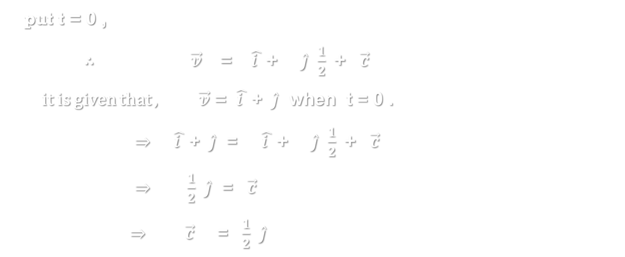
Solution continues…
put t = 0 ,
∴ $\vec{v}$ = $\hat{i }$ + $\hat{j}$ $\frac{1}{2}$+ $\vec{c}$
it is given that , $\vec{v}$ = $\hat{i }$ + $\hat{j}$ when t = 0 .
$⇒$ $\hat{i }$ + $\hat{j}$ = $\hat{i }$ + $\hat{j}$ $\frac{1}{2}$+ $\vec{c}$
$⇒$ $\frac{1}{2}$ $\hat{j}$ = $\vec{c}$
$⇒$ $\vec{c}$ = $\frac{1}{2}$ $\hat{j}$

Slide 8
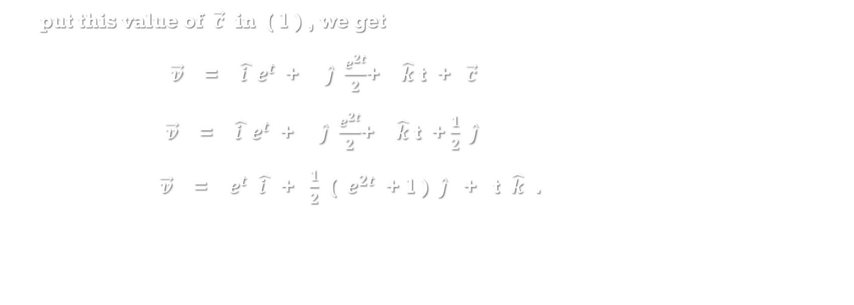
Solution continues…
put this value of $\vec{c}$ in ( 1 ) , we get
$\vec{v}$ = $\hat{i }$ $e^{t}$ + $\hat{j}$ $\frac{e^{2t}}{2}$+ $\hat{k}$ t + $\vec{c}$
$\vec{v}$ = $\hat{i }$ $e^{t}$ + $\hat{j}$ $\frac{e^{2t}}{2}$+ $\hat{k}$ t + $\frac{1}{2}$ $\hat{j}$
$\vec{v}$ = $e^{t}$ $\hat{i }$ + $\frac{1}{2}$ ( $e^{2t}$ + 1 ) $\hat{j}$ + t $\hat{k}$ .

Slide 9
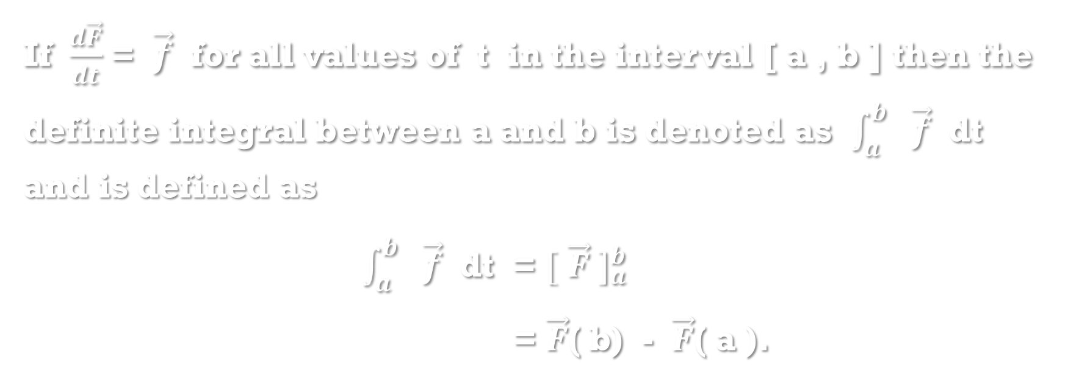
Definite integral :
If $\frac{d\vec{F}}{dt}$ = $\vec{f}$ for all values of t in the interval [ a , b ] then the definite integral between a and b is denoted as $\int_{a}^{b}{ \vec{f}}$ dt and is defined as
$\int_{a}^{b}{ \vec{f}}$ dt = ${[ \vec{F} ]}_{a}^{b}$
= $\vec{F}$( b) - $\vec{F}$( a ).

Slide 10
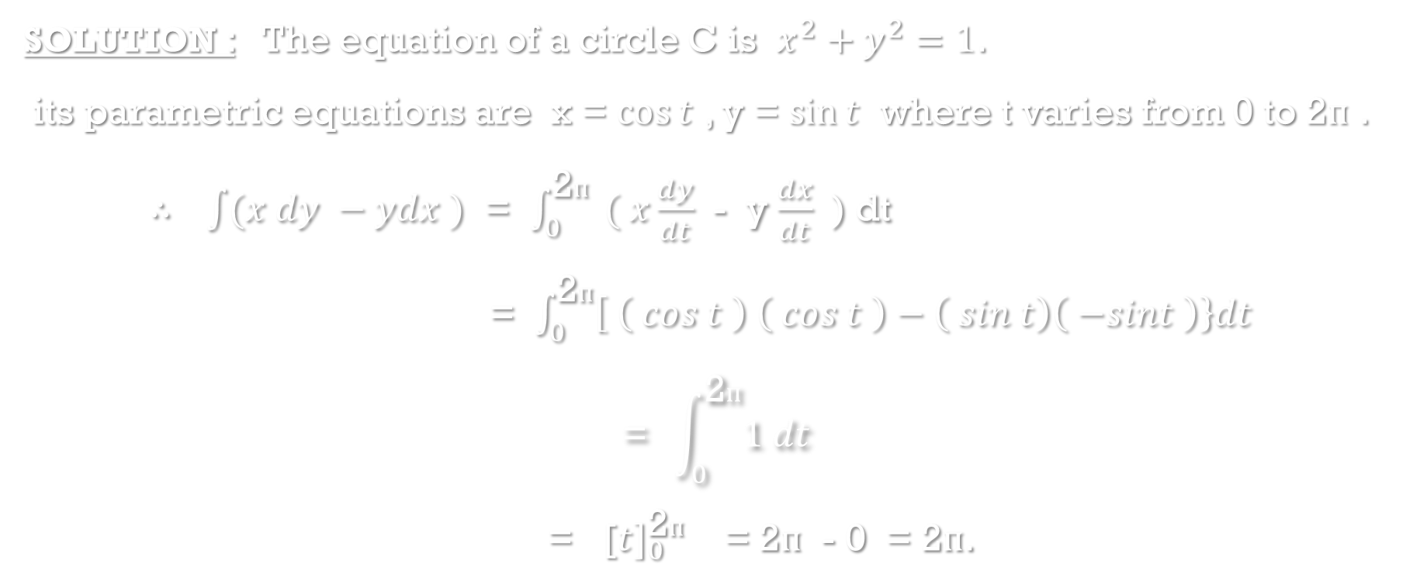

Problem 3 : Evaluate $\int{(x dy −ydx )}$ around the circle $x^{2}+y^{2}=1$.
SOLUTION : The equation of a circle C is $x^{2}+y^{2}=1$.
its parametric equations are x = $\cos{t}$ , y = $\sin{t}$ where t varies from 0 to 2$ᴨ$ .
∴ $\int{(x dy −ydx )}$ = $\int_{0}^{\text{2}ᴨ}{ ( x\frac{dy}{dt} }$ - y $\frac{dx}{dt}$ ) dt
= $\int_{0}^{\text{2}ᴨ}{\left[ \left( cos t \right) \left( cos t \right)−\left( sin t\right)\left( −sint \right)\right\}dt}$
$$\text{= }\int_{0}^{\text{2}ᴨ}{1 dt}$$
= [${t]}_{0}^{\text{2}ᴨ}$ = 2$ᴨ$ - 0 = 2$ᴨ$.

Slide 11
THANKYOU

